Slide 1
Proposal
Wade Lu

Slide 2
Problem Statement
Input
A set of switch and a set of flow
Task
Determine the location of flow
Objective
Minimize the biggest ARE

Slide 3
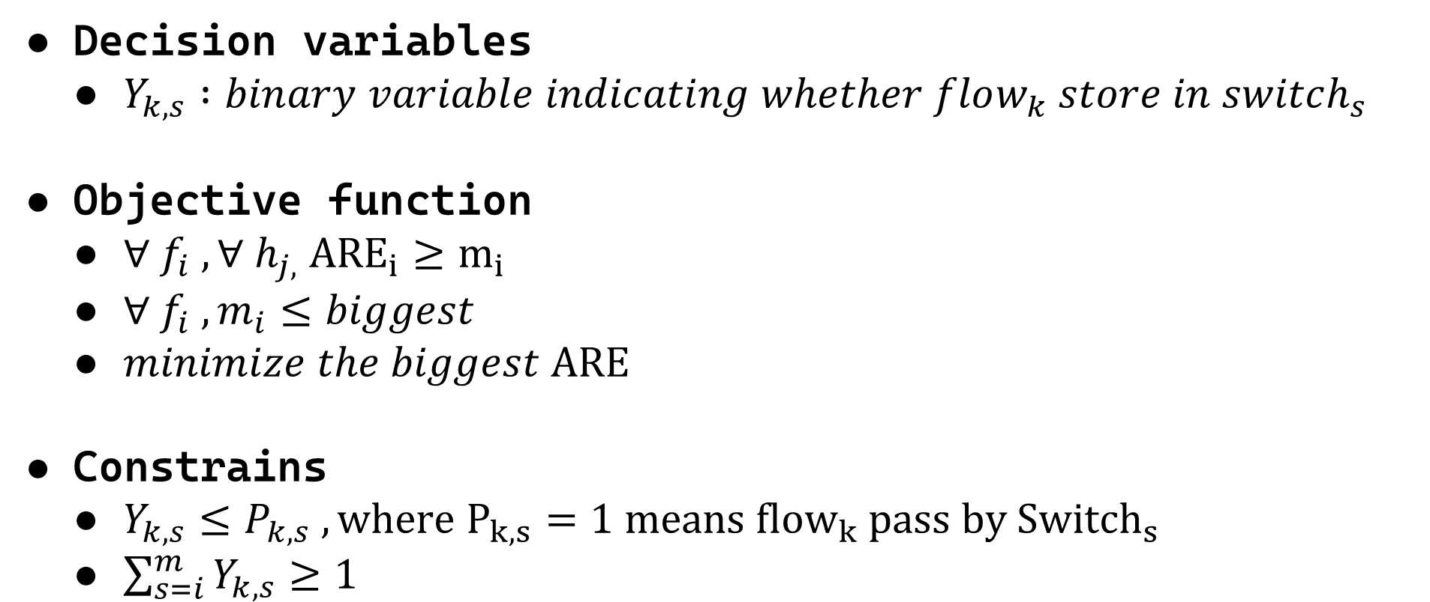
Decision variables
$Y_{k,s} :binary variable indicating whether flow_{k} store in switch_{s}$
Objective function
$∀ f_{i} ,∀ h_{j,} {ARE}_{i}≥m_{i}$
$∀ f_{i} , m_{i}≤biggest$
$minimize the biggest ARE$
Constrains
$Y_{k,s}≤P_{k,s} ,where P_{k,s}=1 means {flow}_{k} pass by {Switch}_{s}$
$\sum_{s=i}^{m}{Y_{k,s}≥1}$

Slide 4
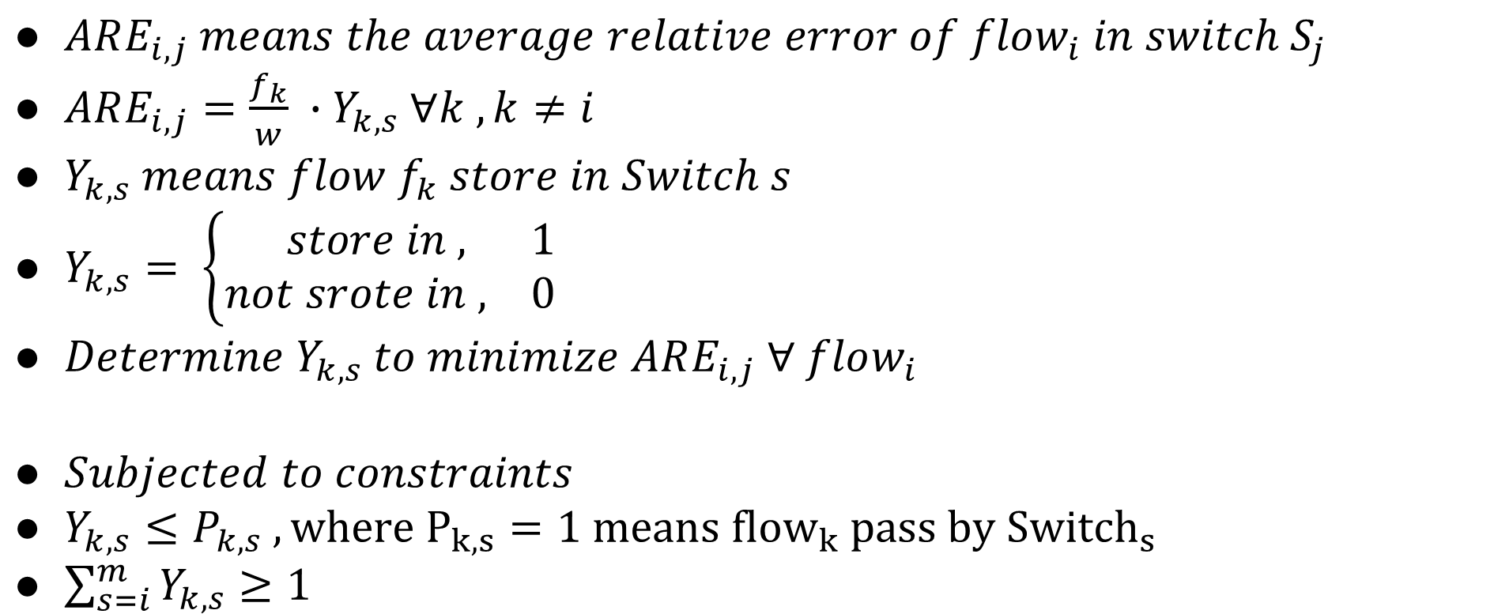
$ARE_{i,j} means the average relative error of flow_{i} in switch S_{j}$
$ARE_{i,j}=\frac{f_{k}}{w} ∙Y_{k,s} ∀k , k≠i$
$Y_{k,s} means flow f_{k} store in Switch s$
$Y_{k,s}= \left\{\begin{aligned} store in , 1 \\ &not srote in , 0\end{aligned}\right.$
$Determine Y_{k,s} to minimize ARE_{i,j} ∀ flow_{i}$
$Subjected to constraints$
$Y_{k,s}≤P_{k,s} ,where P_{k,s}=1 means {flow}_{k} pass by {Switch}_{s}$
$\sum_{s=i}^{m}{Y_{k,s}≥1}$

Slide 5

$∀ f_{i} ,∀ h_{j,} {ARE}_{i}≥m_{i}$
$∀ f_{i} , m_{i}≤biggest$
$minimize the biggest ARE$

Slide 6
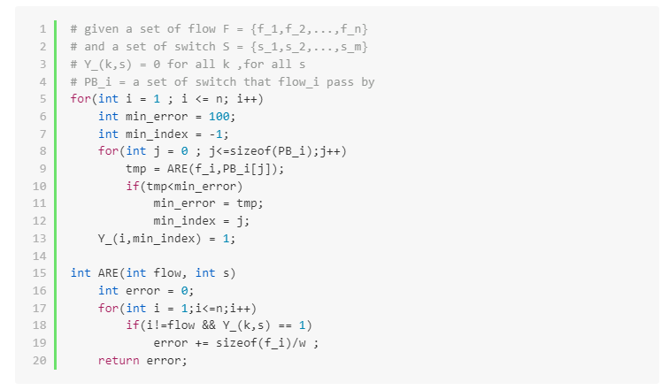

Slide 7
Idea

Slide 8




Teamwork
F1
F2
F2
F2
Src
S2
S4
F1
F1
S1
S3
Dst
Notes:
如何分配 (依據line rate來決定間的數量
Switch如何分辨flow

Slide 9

未知的作者 的 此相片 已透過 CC BY-NC 授權

